Slide 1
Evidence of Anti-Politics in Britain?
Gerry Stoker University of Southampton and University of Canberra
@ProfStoker

Slide 2
Starting points
Anti-politics is an awkward and potentially misleading term
Disillusionment and disengagement from mainstream politics
Not just a British Phenomenon
Evidence about it collected in a range of ways

Slide 3
Never a golden age?
“Politicians. Not all self-seekers or gas-bags. Some climbers, no doubt as in other walks of life, but even so, electors to blame if they don't get 'value for their money”
“Views of politicians: Themselves: servants of the people. Critics: out to feather own nests; gas-bags”.

Slide 4
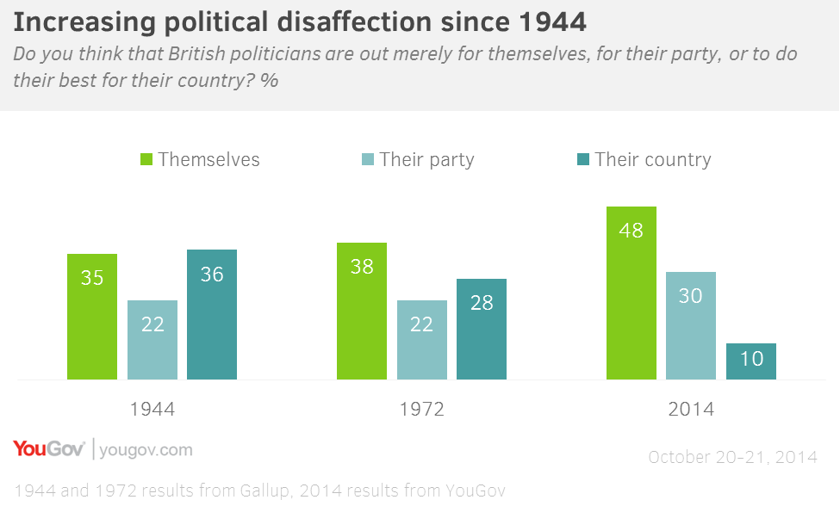
But some evidence of decline
Source: YouGov/University of Southampton, 2,103 GB Adults, Fieldwork: 20th - 21st October 2014

Slide 5
So what’s different?
Politics always a difficult art and has disappointment built into its practices
Take a system view: could explore inputs, throughputs or outputs
A void at the heart of politics: mind the gap
Modern political exchange is increasingly in fast thinking mode: in the way it is consumed and the way its offered

Slide 6
Expressions of discontentment
Thinking about the problems facing Britain today, do you agree or disagree with the following statements? | Agree/Disagree (%)
Politicians in government can make a difference to the major social and economic issues facing Britain. | 63 / 13
Politicians have the technical knowledge needed to solve the problems facing Britain today. | 20 / 52
Politicians possess the leadership to tell the public the truth about the tough decisions that need to be made. | 33 / 40
Politicians are too focused on short-term chasing of headlines. | 80 / 3
Politics is dominated by self-seeking politicians protecting the interests of the already rich and powerful in our society. | 72 / 8
Politicians have exaggerated the scale of the economic crisis - by blaming either the previous or the current government. | 47/28
Source: YouGov/University of Southampton, 1,905 GB Adults, Fieldwork: 5th – 6th June 2013

Slide 7
Why does anti-politics matter? Direct electoral impact: tipping point
Belief that politicians are “merely out for themselves” explains as much variance in support for UKIP as several demographic factors (via Ford & Goodwin): 55+, male, working class.
Odds of supporting UKIP are three times higher if respondents believe politicians are self-serving.
Driving support for other parties and non-voting too

Slide 8
Anti-politics reinforces exclusion
Disillusionment leads to non-participation in long-term
Populist surges likely to be followed by slump
Its clear who owns disillusionment to a greater degree
Politics designed around interests of those that remain in: the wealthier ...and those that vote, the elderly not the young

Slide 9
Policy impact: false choices
Sound bites hide real choices that are being made
The extent of the void between politicians and citizen limit the scope for “honest” discussion

Slide 10
And solutions?
Engaging citizens in slow reflection and decision ( its hard but it works)
Building on the innocence of youth
Changes to the practices of politics are the key : some of that being delivered but more required
Seeing May 8th as an opportunity to refresh politics further in a sustainable way
Above all about changing the culture of politics

Slide 11
Source: Data from Hansard Society (2013) Audit of Political Engagement
Reform preferences for improving politics
Which of the following changes do you think would improve the British political system the most? Please pick up to three.
 | %
Make politics more transparent so that it is easier to follow | 48
Make politicians more accountable for their performance between elections | 39
Better information and education about politics for all citizens | 32
Less ‘spin’ in political communication | 26
Give citizens more of a say (e.g. more referendums, more consultation) | 29
Get experts more involved in decision-making | 17
More positive media coverage of politics | 12
Constitutional changes (e.g. an elected House of Lords, a different voting system) | 8
More people like me as MPs | 6
None of these | 11

